Slide 1
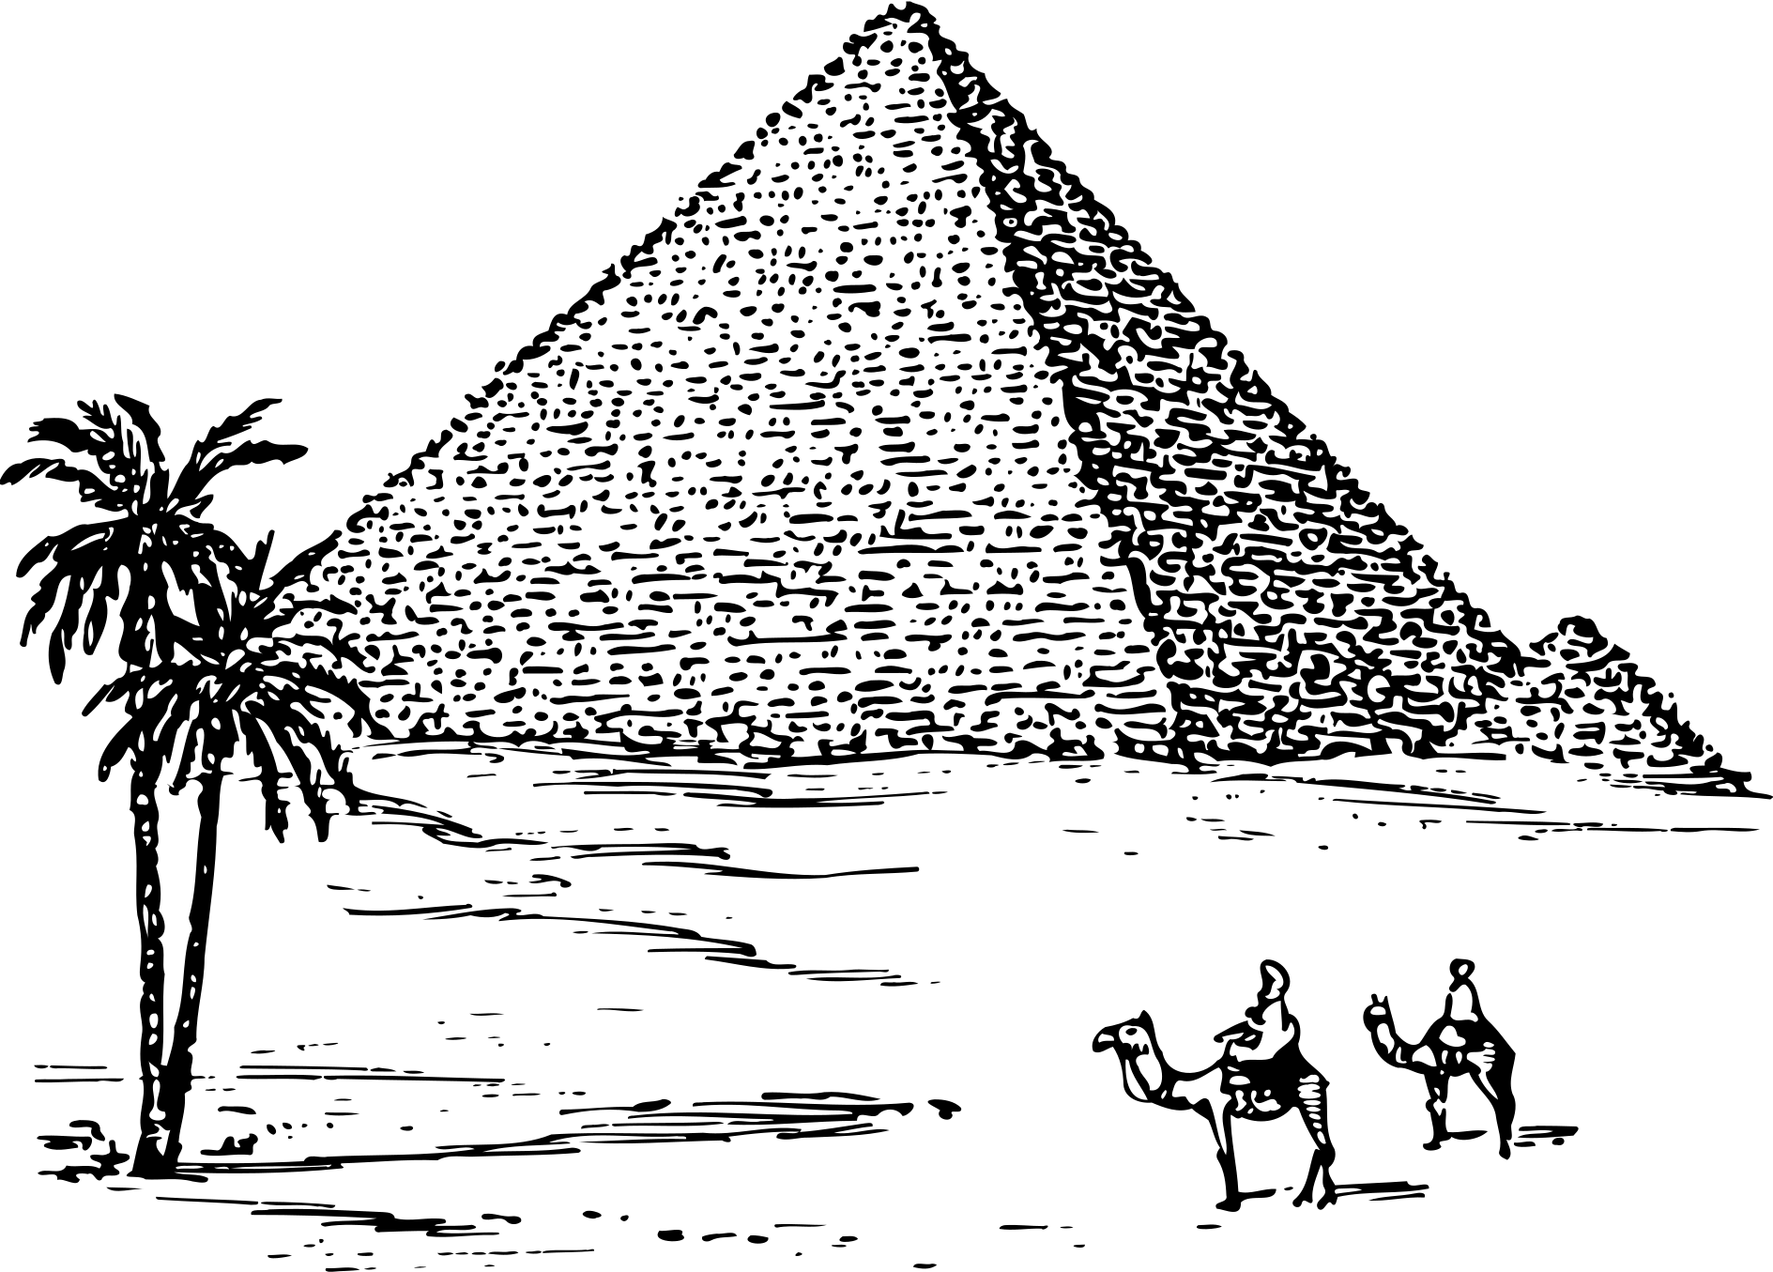



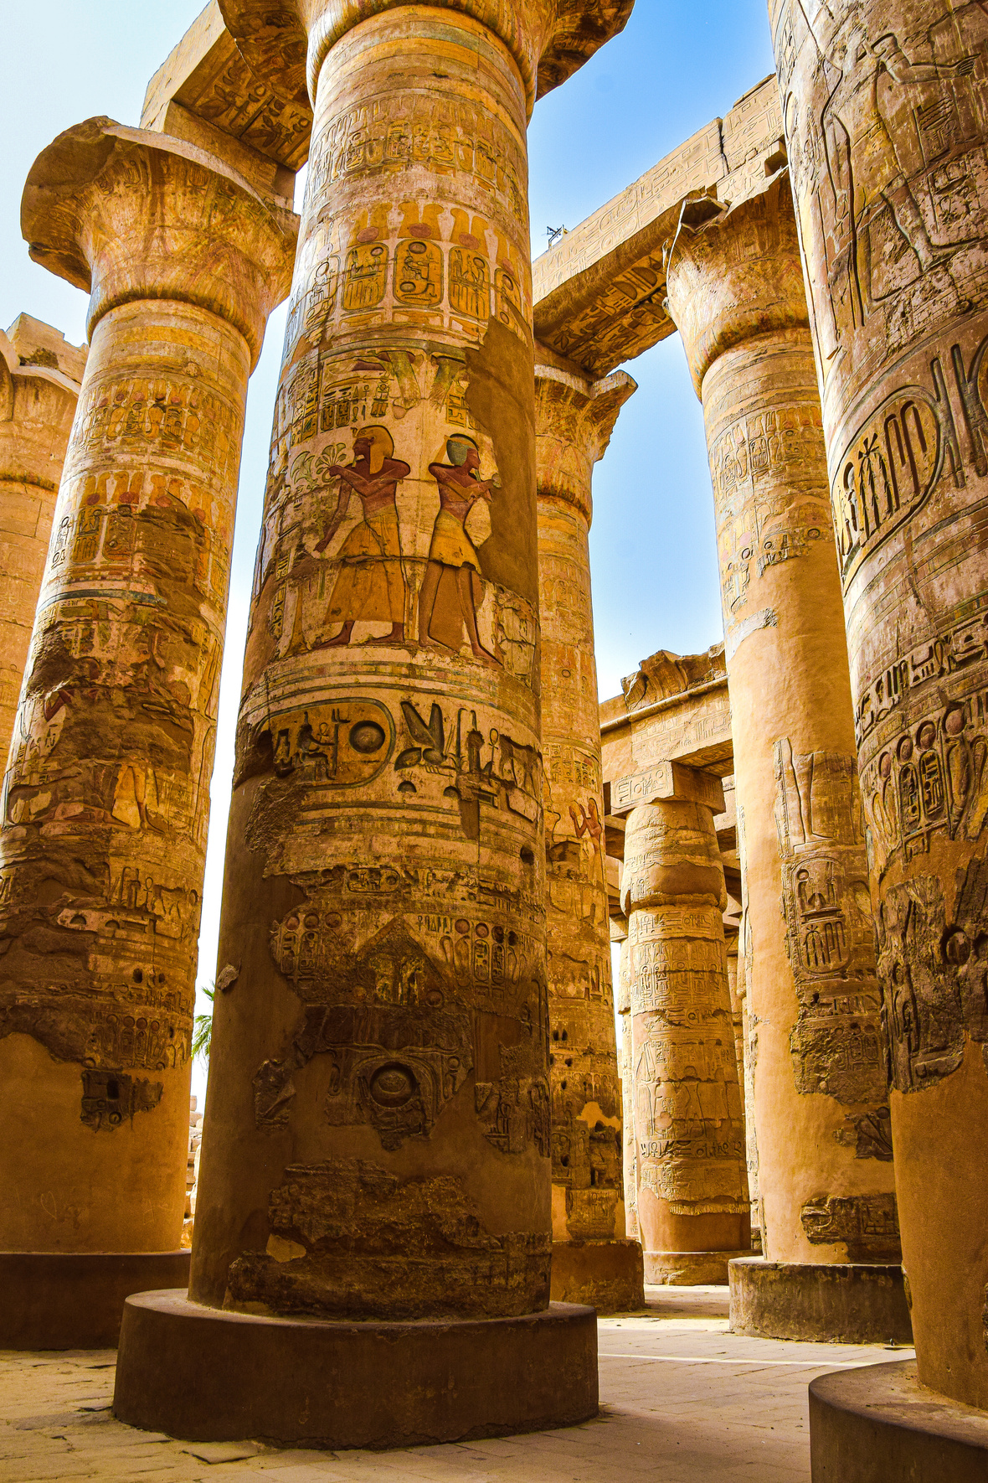
WANDER WISE

Slide 2

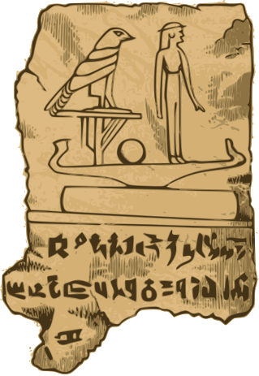
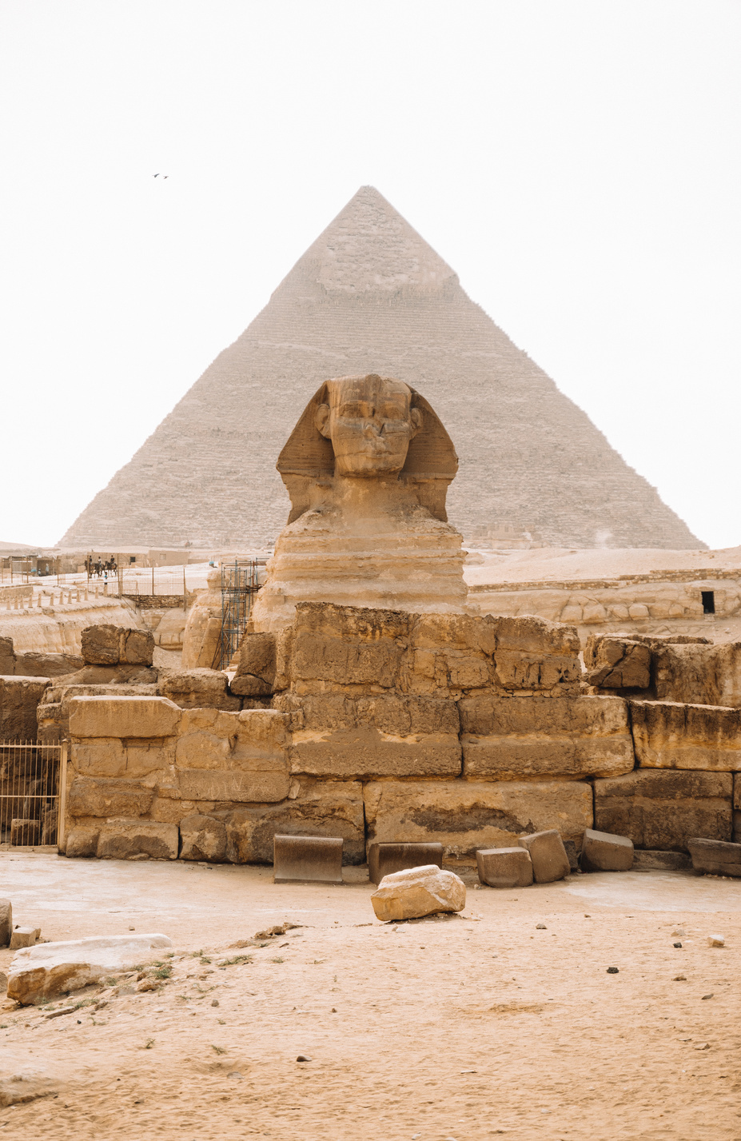


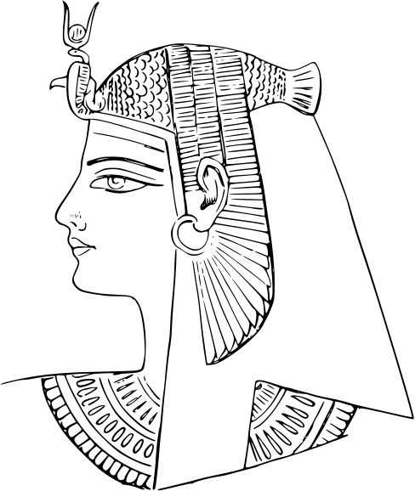
Agenda Page
1- Problem Statement
2-Pains
3- Our Solutions
4- Demo

Slide 3

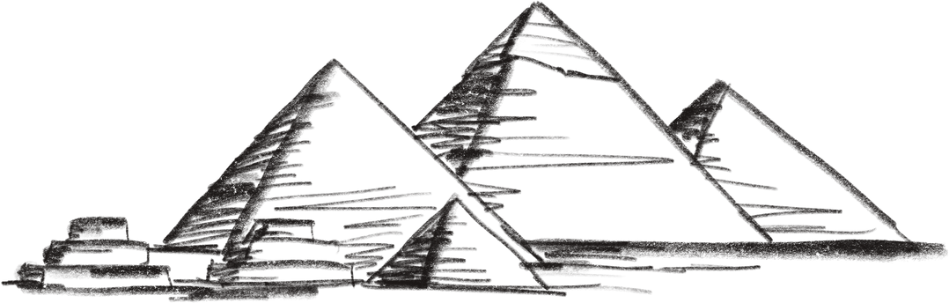
The Economic Lifeline — Why Tourism Matters to Egypt
Tourism is one of Egypt’s top economic pillars, accounting for ~12% of GDP and employing over 2.5 million Egyptians (UNWTO, 2023).
In 2010, Egypt’s tourism reached a peak:
→ 14.7 million visitors
→ $12.5 billion in revenue
→ 11%+ of national GDP
Largest source of foreign currency — tourism revenues outpace remittances and Suez Canal fees in some years.

Slide 4
A Decade of Disruption — From Revolution to Pandemic
Post-2011 Revolution, tourism collapsed due to political instability and safety concerns.
COVID-19 was a second major blow — tourism dropped by 70% in 2020, bringing widespread poverty and unemployment.
While 2023 saw a recovery (13M+ tourists), it still hasn’t surpassed pre-2010 levels.

Slide 5

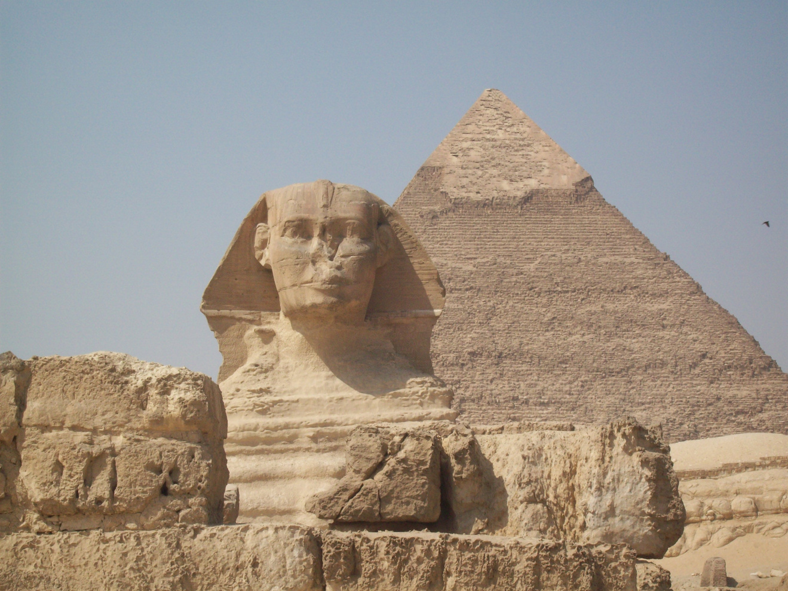
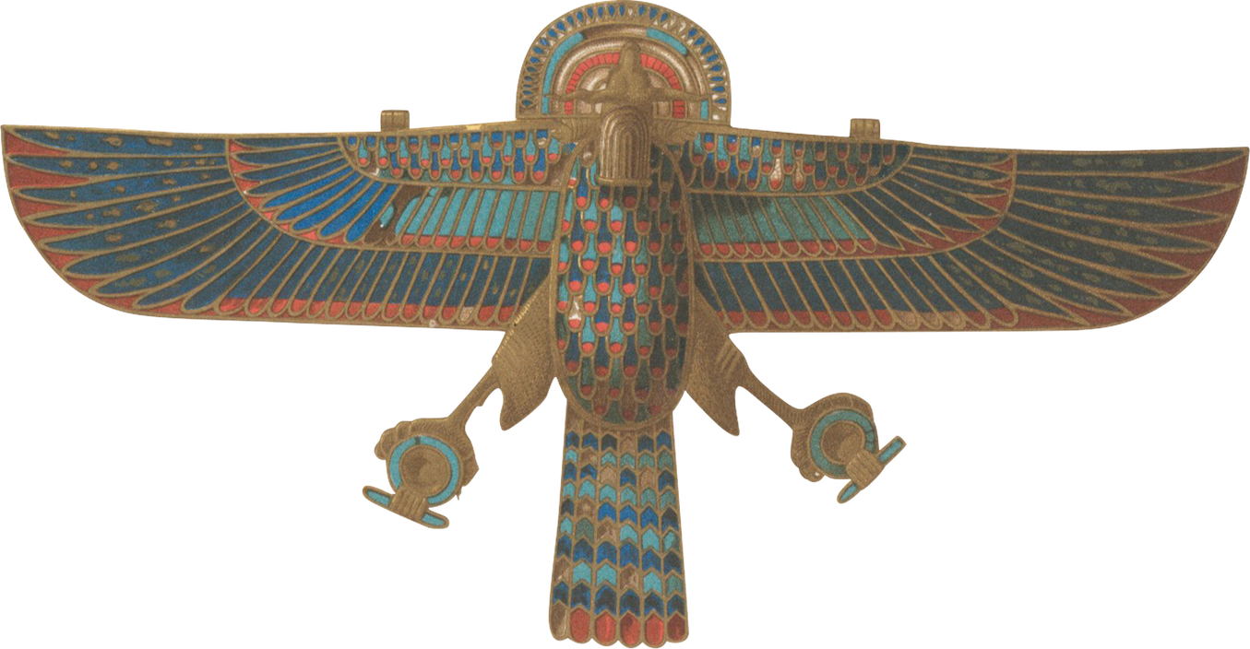

WHAT IS THE PAIN IN TOURISTS’ POV?

Slide 6
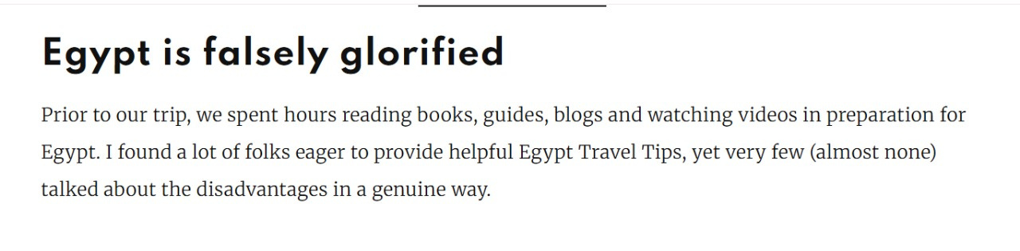
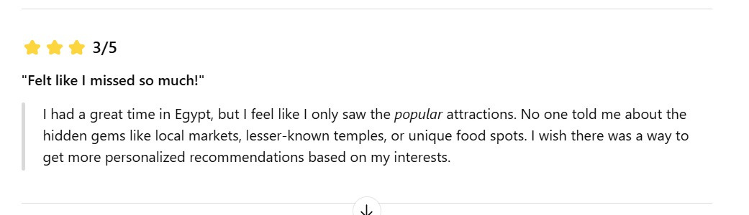
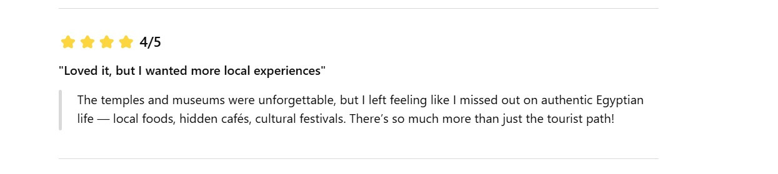
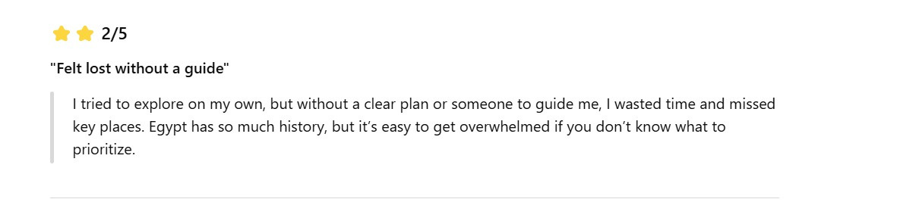


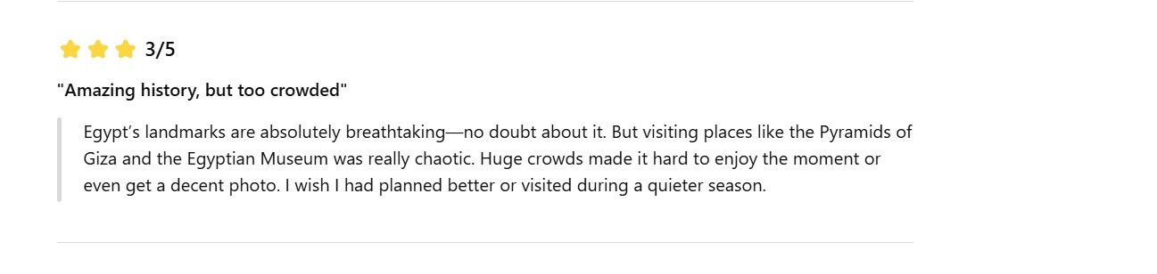

Slide 7
The Hidden Pain Points in Egypt’s Tourism Today
Over-concentration on a few landmarks (e.g., Pyramids, Luxor, Sharm) → overcrowding
46% of travelers reported overcrowding as a top negative experience (Booking.com, 2023)
Long wait times, disorganization, lack of real-time updates (TripAdvisor reviews)
Underutilized gems in Upper Egypt, Western Desert, etc. — receiving only a few thousand annual visitors
70%+ of tourists visit only a small number of sites (UNWTO)

Slide 8


Our Solution
Pain Point | Our AI Solution
Overcrowding at major landmarks | Mood-Based Recommendation (One-Day)
Lack of planning tools | Prompt-Based RAG Trip Planner (Multi-Day)
Ignored regional gems | Visual Landmark Recommendation (Image + Text)

Slide 9


Novelty & Innovation —What Makes Our System Unique
1. Multimodal AI for Travel Planning
We combine text, mood, and image input to power a fully personalized recommendation experience — something not offered by mainstream travel apps like Booking.com or TripAdvisor.

Slide 10
Novelty & Innovation —What Makes Our System Unique
2. Discovery Beyond the Obvious
We actively recommend underexplored locations based on cultural relevance, visual similarity, and low crowd scores — helping spread tourism beyond Giza and Luxor

Slide 11
Novelty & Innovation —What Makes Our System Unique
3. Smart Planning that Thinks Like a Human — Not a Travel App
Most travel apps dump a list of places and leave the planning to you.
We do it differently.
Our system actually understand your goals, then builds a full-day or multi-day itinerary that makes sense — just like a local expert would.

Slide 12

How This Solution Could be Implemented ?
Physical cheap machines that can be placed literally anywhere (Ancient Sites - Airports - Hotels - Malls)

Slide 13
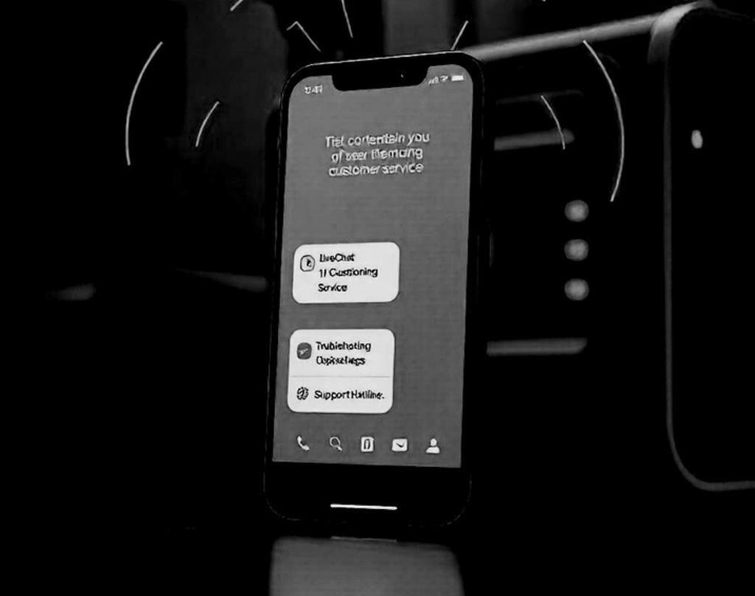
How This Solution Could be Implemented ?
Applying the software in a Mobile App/ Website

Slide 14
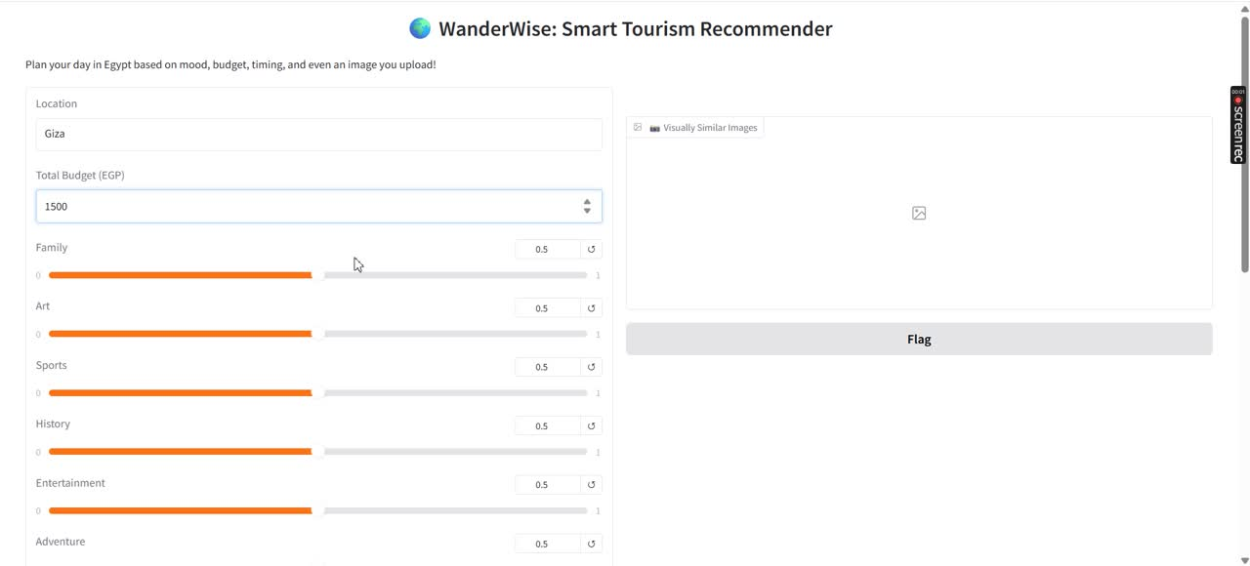
Demo

Slide 15
Thank You

